Slide 1
COVID-19 Vaccine Implementation Advisory Committee
December 4, 2020

Slide 2
Agenda
Updates on EUAs and Vaccine Timing
Federal Pharmacy Program
Updates from Advisory Committee on Immunization Practices (ACIP)
Update on numbers in 1A
Updates on estimated vaccine doses
Draft Prioritization Plan for 1A

Slide 9
Outbreak-Associated Deaths are Primarily from LTCFs

Slide 12
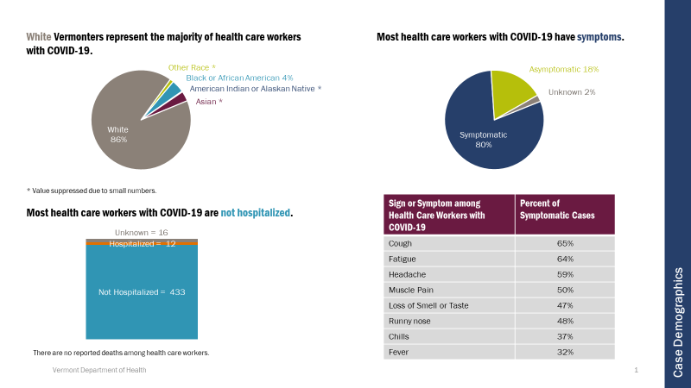

Slide 13
Health Care Personnel - Subprioritization
MMWR: https://www.cdc.gov/mmwr/volumes/69/wr/mm6949e1.htm?s_cid=mm6949e1_w

Slide 14
Phase 1a Population
Long-term Care Workers | 13,636
Licensed healthcare workers | 3,174
Direct care, non-licensed healthcare workers | 3,353
Other staff | 1,765
Residents | 5,344
Hospital Workers | 19,555
Healthcare and Support Staff primarily located in the ED, ICU, or providing care to COVID patients | 4,916
Support Staff not in ED, ICU, or COVID Care | 5,512
Healthcare Workers not in ED, ICU, and COVID Care | 9,127
Other Healthcare Providers | 26,519
EMS Workers | 2,630
Home Health Workers | 10,934
Other Healthcare Workers | 12,955
Grand Total | 59,710

Slide 15
Proposed Phase 1a
Phase 1A: Health care workers (HCW) likely to be exposed/treat COVID-19 patients
Long-term care facility residents and staff who have patient contact
Clinical and support staff who have patient contact– priority should be given to the following groups:
HCW (all classes including support personnel) primarily located in the ED and ICU, providing care to COVID patients
EMS with patient contact
Home health care clinical staff and caregivers who have contact with multiple patients/vulnerable people
Other health care providers/staff who have patient contact

